Slide 1

Ending fossil fuel subsidies
Rod Campbell, November 2024

Slide 2
Australia – FFS! (Fossil Fuel Subsidies)
$14.5 billion in 2023–24, up 31% on 2022–23!
$27,581 for every minute of every day.
$540 for every person in Australia.
More than spent on army or air force
…all to make climate change WORSE!!!

Slide 3
What is a subsidy?
No strict definition – so different estimates of FFS:
  IMF - $44 billion
  Australia Institute - $14.5 billion
  Productivity Commission - $1 billion
World Bank:
A financial contribution by a government or public body or any form of income or price support that "confers a benefit" on the recipient (an enterprise, an industry, or a group of enterprises or industries)….
[Including] Reduction of taxes paid. Egs include exemptions or reductions from taxes normally applied, such as …tax credits.

Slide 4
What is a subsidy?
Queensland Treasury:
“Governments face budget constraints and spending on mining related infrastructure means less infrastructure spending in other areas, including social infrastructure such as hospitals and schools. The opportunity cost of this use of limited funds is a real cost to government and the community.”
In budget papers, reduces spending in other areas.
Basic econ policy rule – tax what you want less of, subsidise what you want more of.

Slide 5
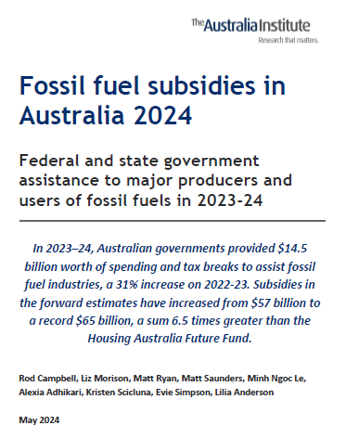
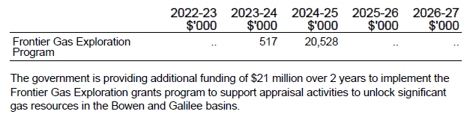
Examples of Aus fossil fuel subsidies

Slide 6
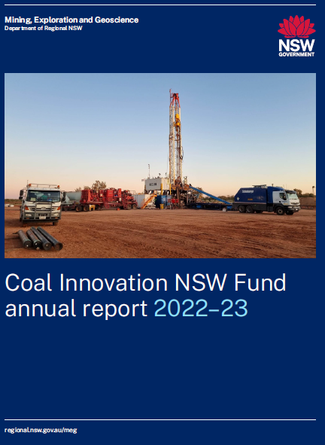
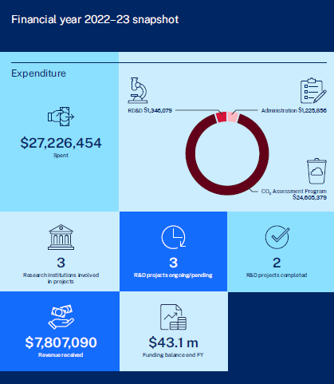
Examples of Aus fossil fuel subsidies

Slide 7
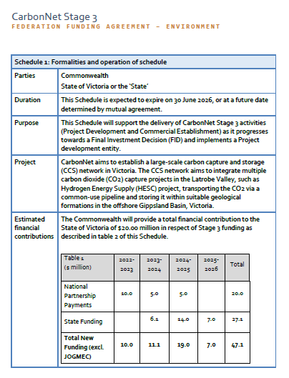
Examples of Aus fossil fuel subsidies

Slide 8
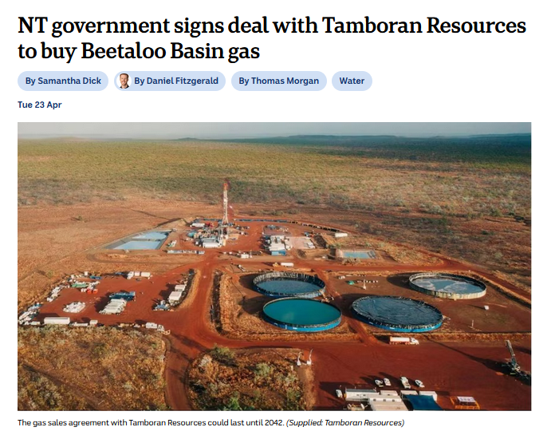
Examples of Aus fossil fuel subsidies

Slide 9
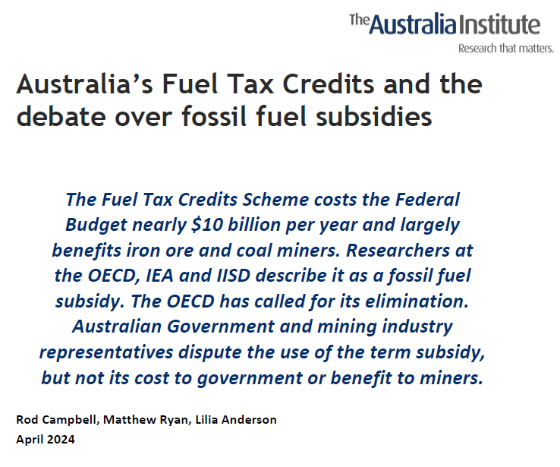
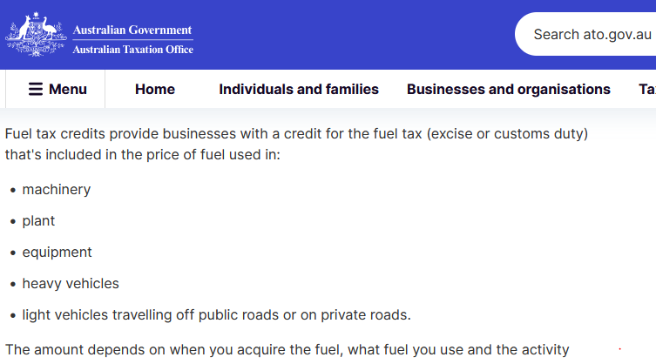
The big one! Fuel Tax Credit Scheme

Slide 10
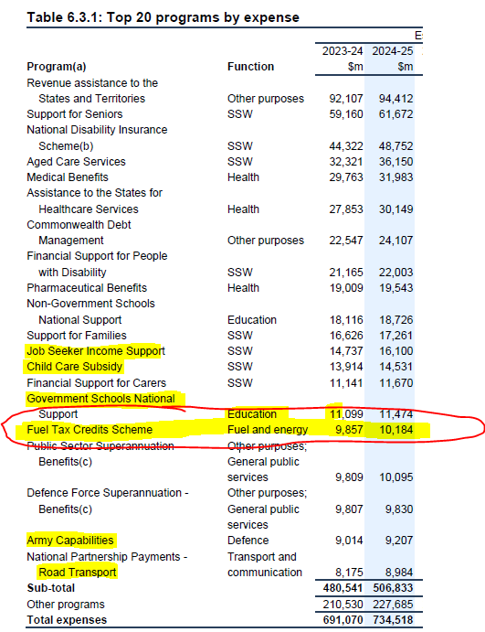
The big one! Fuel Tax Credit Scheme

Slide 11
The big one! Fuel Tax Credit Scheme

Slide 12
The big one! Fuel Tax Credit Scheme

Slide 13
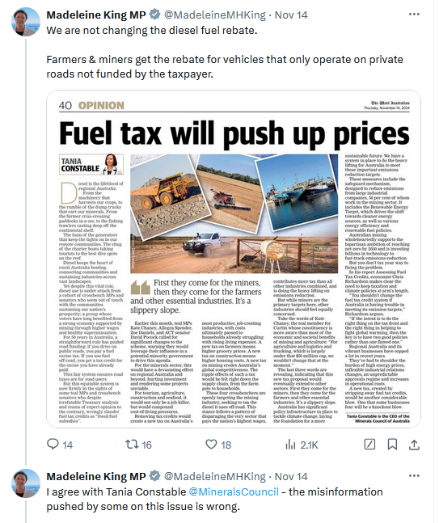
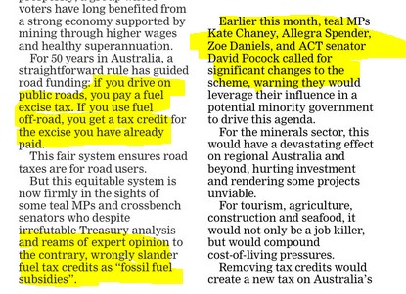
The big one! Fuel Tax Credit Scheme

Slide 14
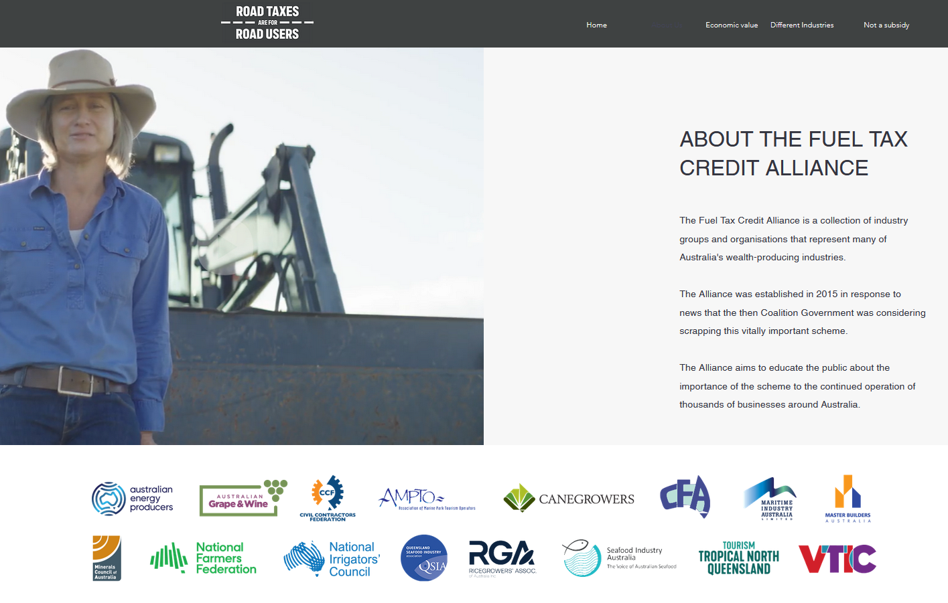
The big one! Fuel Tax Credit Scheme

Slide 15


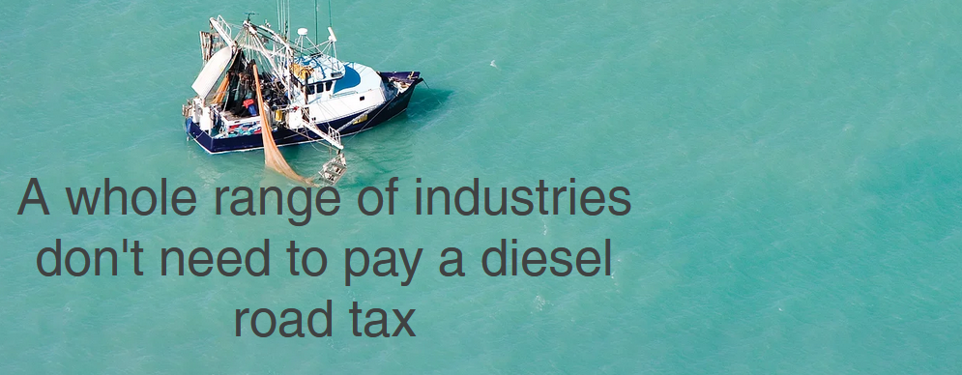
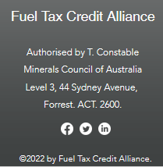
The big one! Fuel Tax Credit Scheme

Slide 16
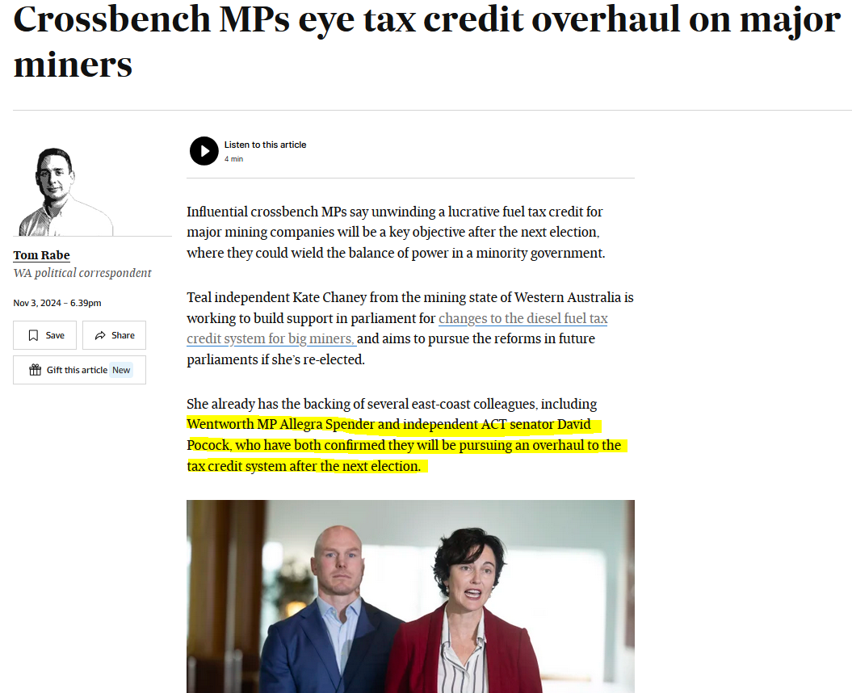
Conclusion – signs of change!

Slide 17
Fossil fuel subsidies
Questions????

Slide 18

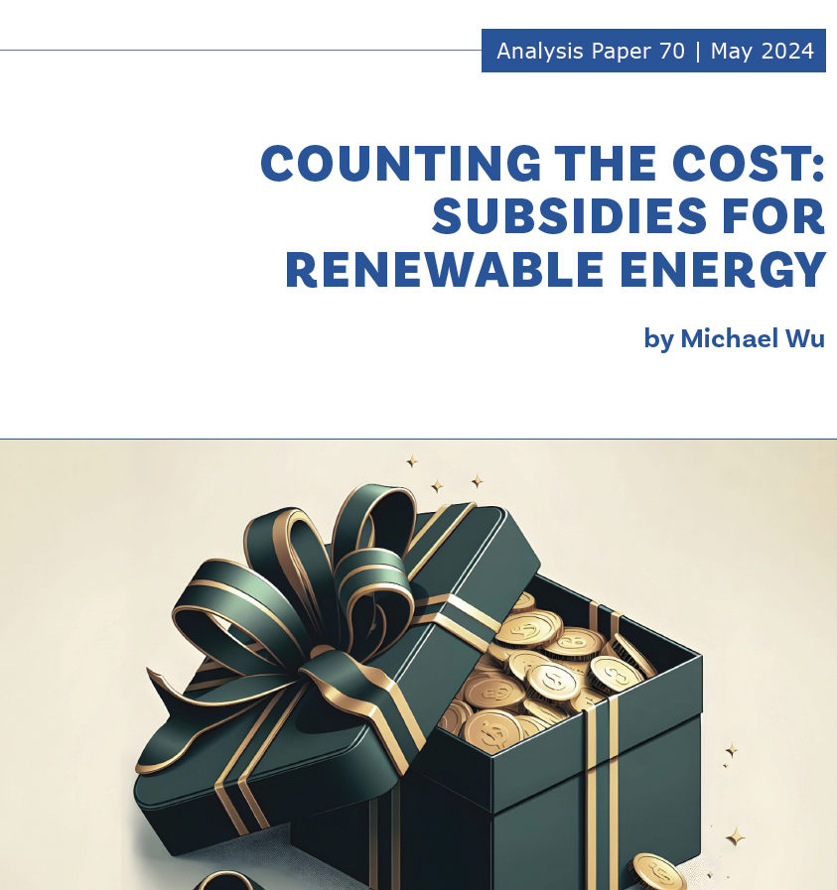
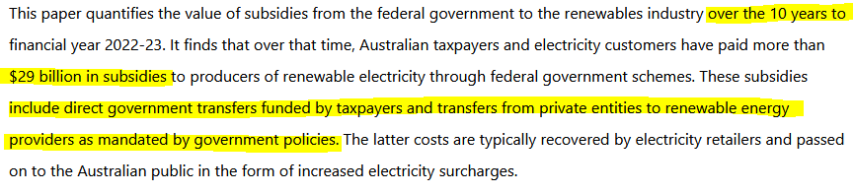
Renewable subsidies
$2.9b per year

