Slide 1
Phasing out the gas industry
Rod Campbell, October 2024

Slide 2
Australia should phase out gas
Why? Because climate change…details.
Will we run out of gas? No…details
Will gas prices go up? No…
What about jobs? There’s hardly any…
Don’t we get lots of money from gas exports? No…
OK, you’re right. No new gas projects!

Slide 3
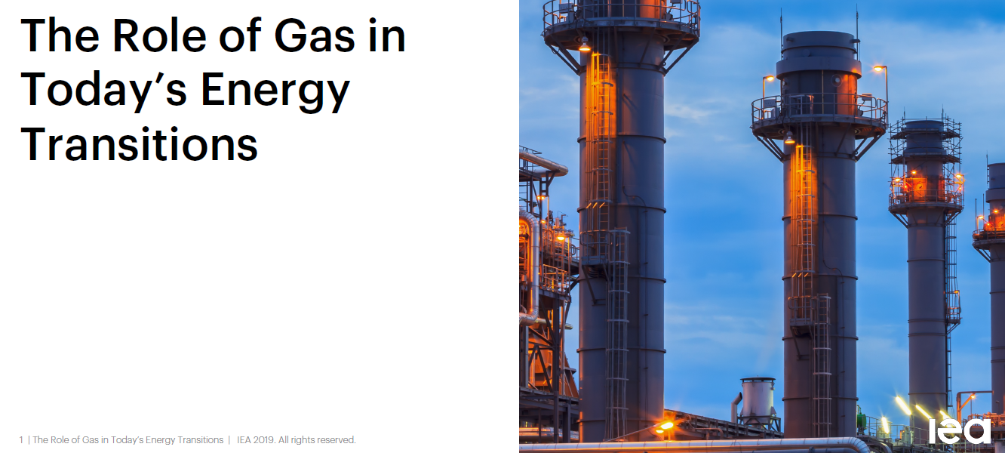
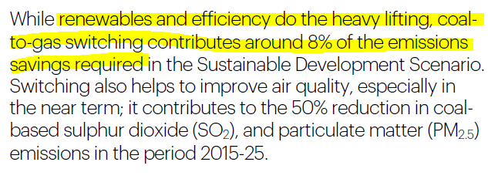
Gas and climate

Slide 4
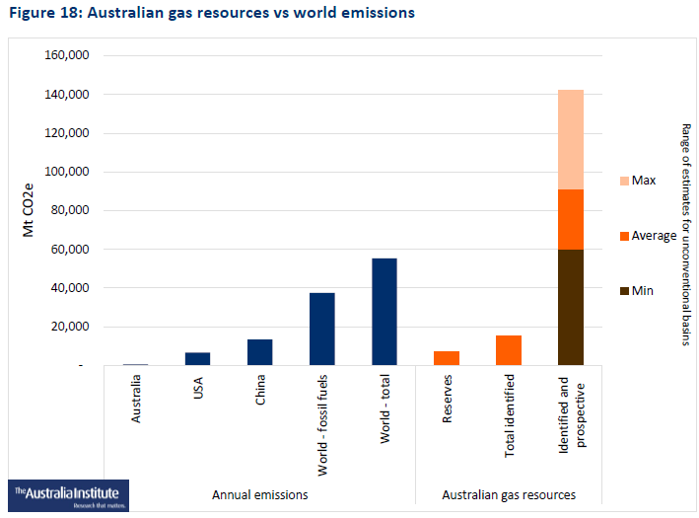
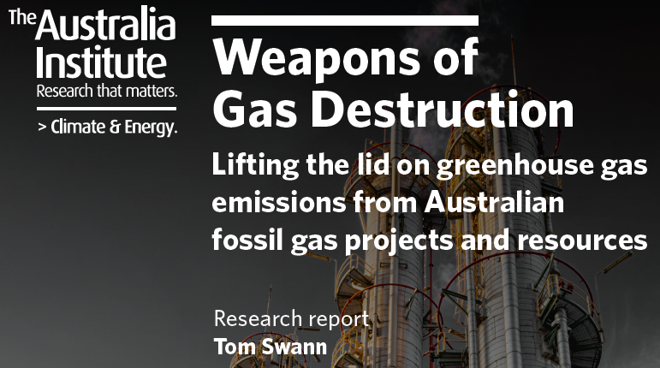
Gas and climate

Slide 5
Gas and climate
Source: Australia's National Greenhouse Accounts

Slide 6
Will we run out of gas?
Sources: Australian Energy Statistics, Australian Energy Updates.

Slide 7
Will we run out of gas?

Slide 8
Will gas prices go up?
Source: Australian Energy Regulator, wholesale gas market prices.

Slide 10
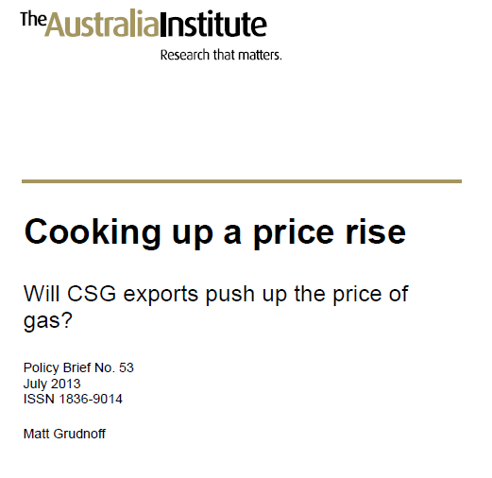
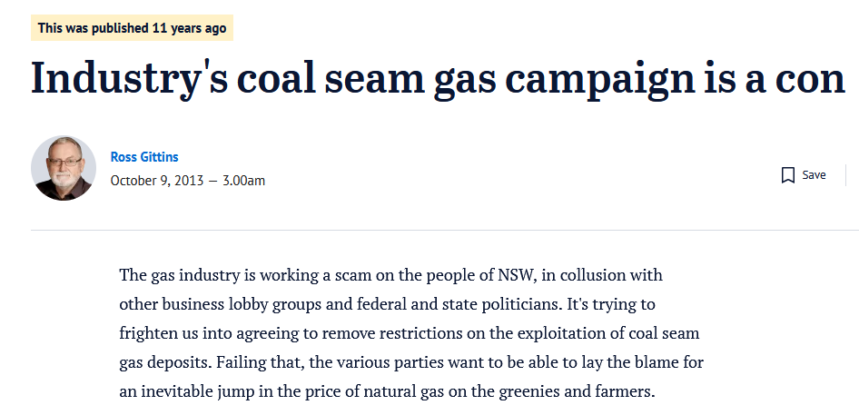

Slide 11
No jobs on a dead planet…or in gas

Slide 12
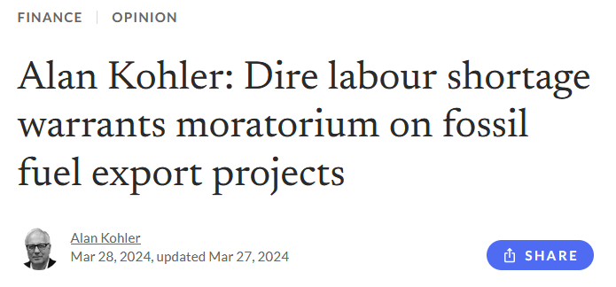
New gas construction crowds out housing and infrastructure

Slide 13
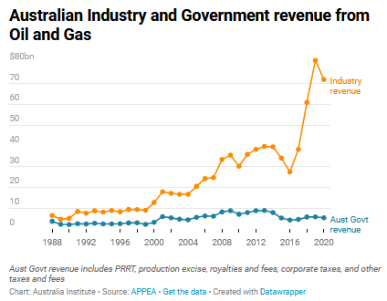
Australia gets no money from gas

Slide 14
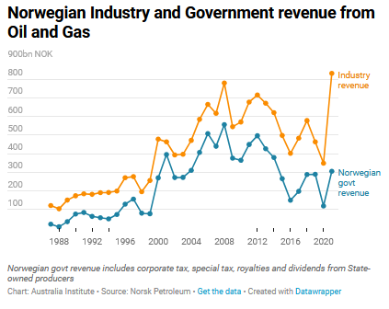
Australia gets no money from gas

Slide 15
Australia gets no money from gas
Changes:
Shift from royalties to Petroleum Resource Rent Tax (PRRT)
Industry changed from domestic piped gas to LNG exports.

Slide 16
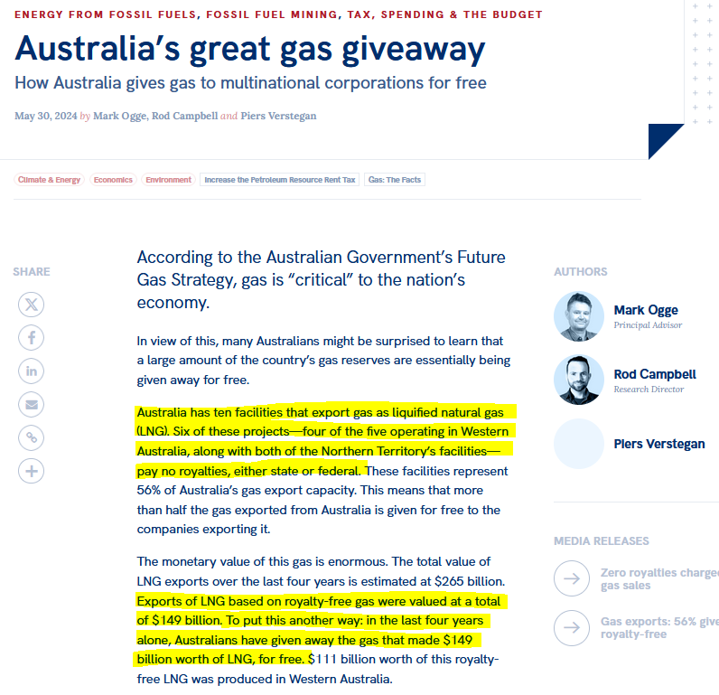
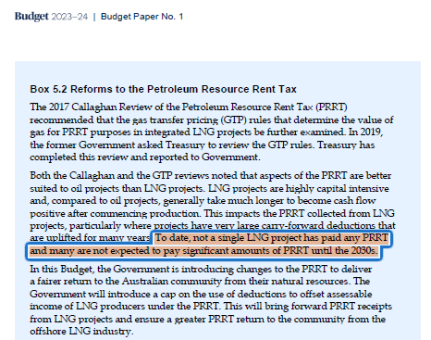
Australia gets no money from gas

Slide 17
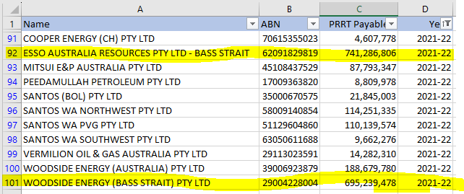
Australia gets no money from gas

Slide 18
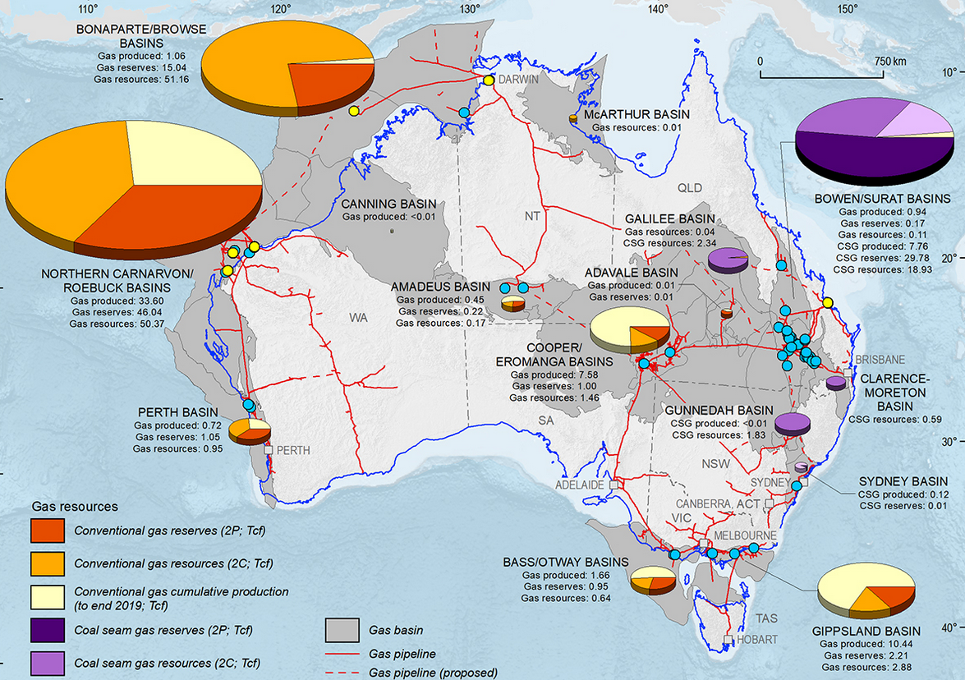
Why no money from gas?

Slide 19
Why no money from gas?

Slide 20
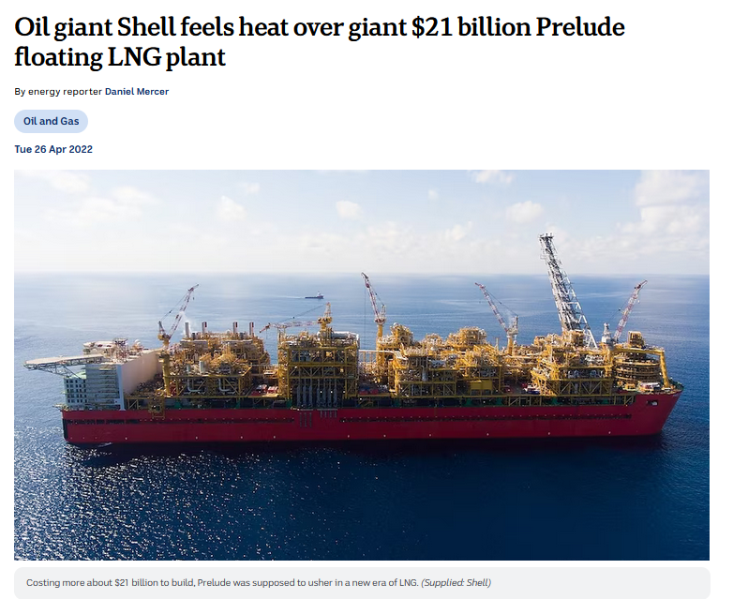
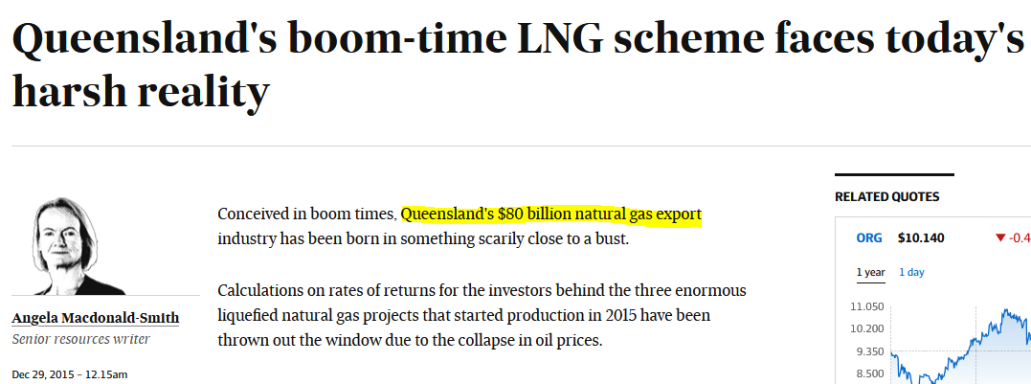
Why no money from gas?

Slide 21
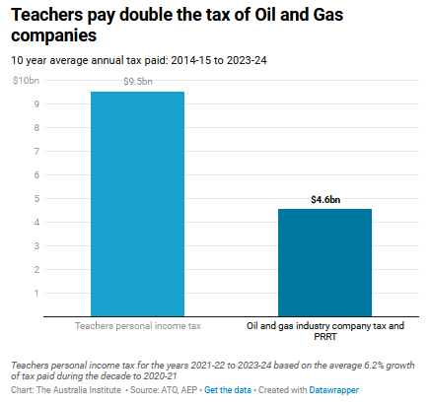
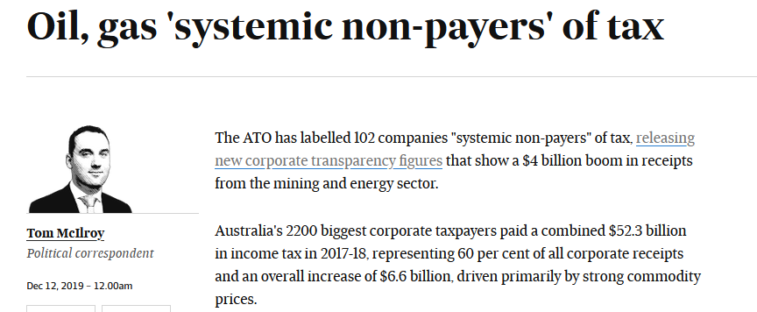
Why no money from gas?

Slide 22
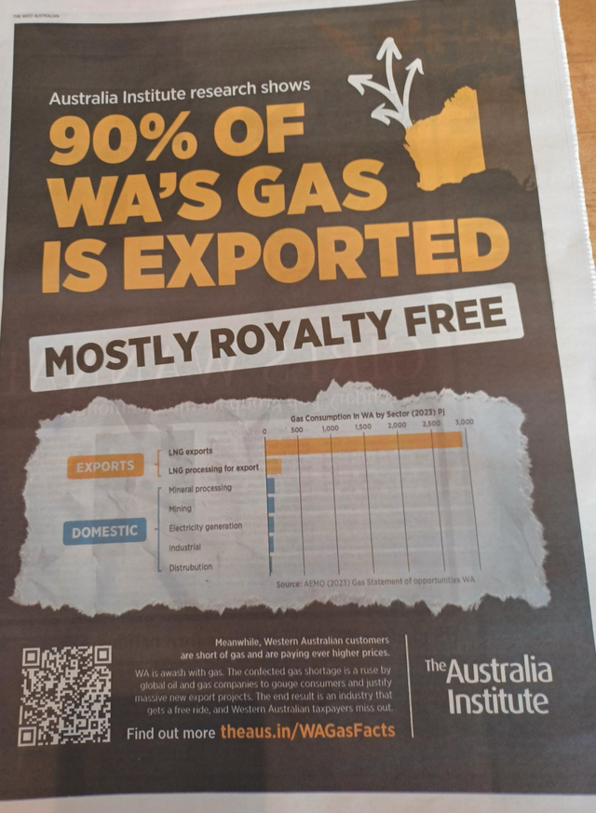
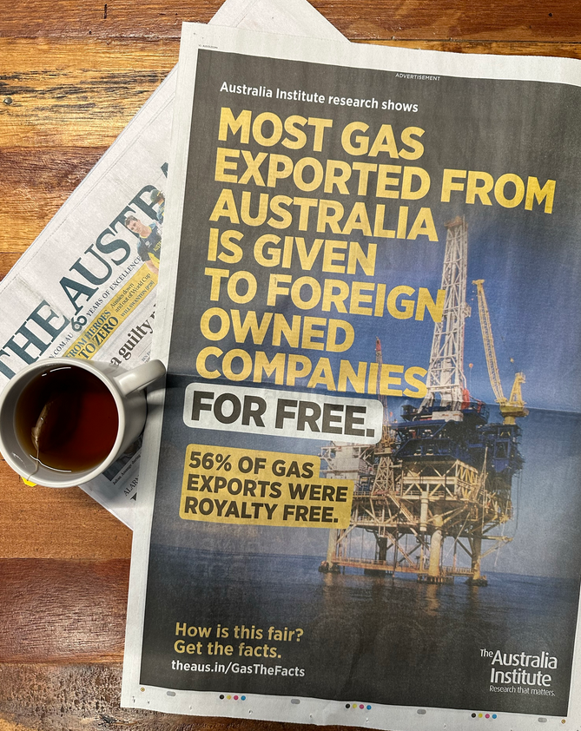
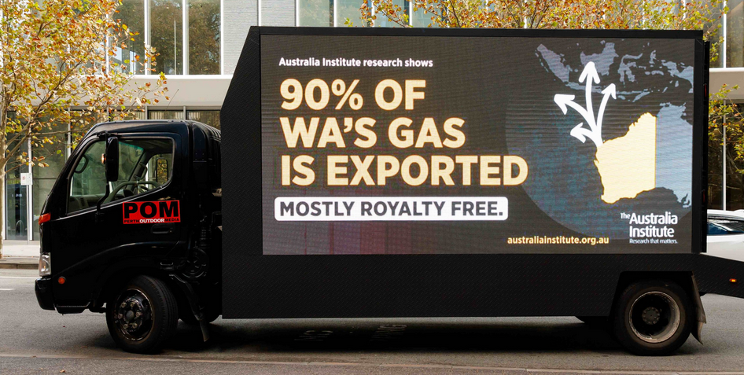

Slide 23
